Slide 1
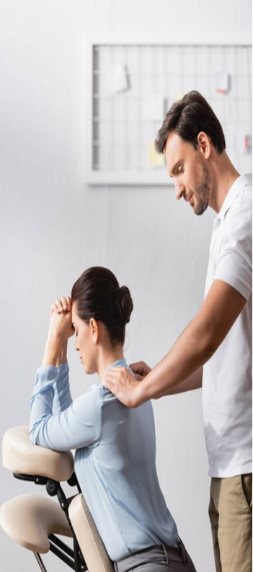
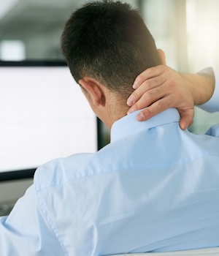

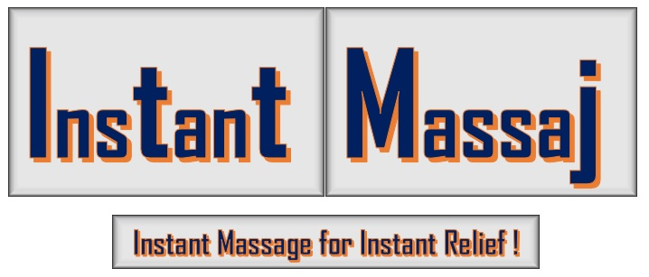
We better evaluate your PAIN…
Are you stressed, in pain & anxiety due to long working hours?
We can help!
Sam Instant Massage Clinic (SIMC)
At SIMC, 1000 hrs. qualified Massage Therapist (MT) examine your body pain, your nature of work, posture and provide appropriate therapeutic and relaxation massage at an affordable cost. Our MT also recommend appropriate physical workout and life style changes that suits your body.
Abdul Samad (Massage Therapist)
Victoria Square Shopping Centre ​
East Regina, 2223 Victoria Avenue Ave
S4N 6E4 SK, Regina Canada
Tel : 1(306) 807 2012​
E-mail: instantmassageinfo@gmail.com
Website: https://saminstantmassaj.com/
Note: If you don’t get appointment, no problem we accept Walk-ins. Within 20-30 min our RMT will attend you.
Contact
ADATUM FITNESS
INSTANT Massaj for INSTANT Relief!
Health is a journey, not a destination​

Slide 2

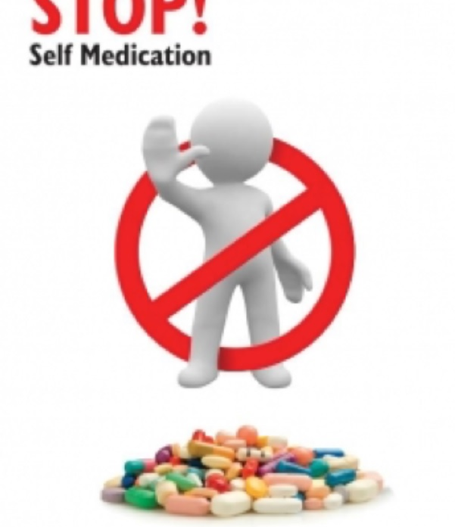
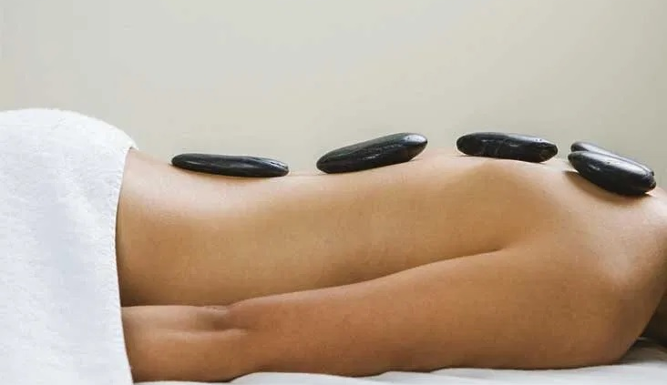
Self-medication Can be Dangerous​
Generally, people suffering from body pains, headache, fibromyalgia and job stress seek self medication whereas, literature suggests that Self-medication with NSAIDS may leads to serious adverse effects and complications. Instead, simple exercise and a relaxation massage treatment gives instant relief from the pain in a natural way.
Most of adolescents often seek artificial means to gain advantage to prolong work activities. The intension of this informative literature is to prevent harmful side effects of long-term usage of NSAID and spread awareness in the society. Hot stone massage not only increase blood flow, prevent cellular destruction enhance sleep.
Benefits of Hot Stone Massage​
A modern hot stone massage is a treatment which perfectly complements physiotherapeutic activity which goal is the restoration of the damaged organs. What is more, it is also applied in wellness clinics, accelerating recreational processes, thus increasing the body's ability to exercise..

Slide 3
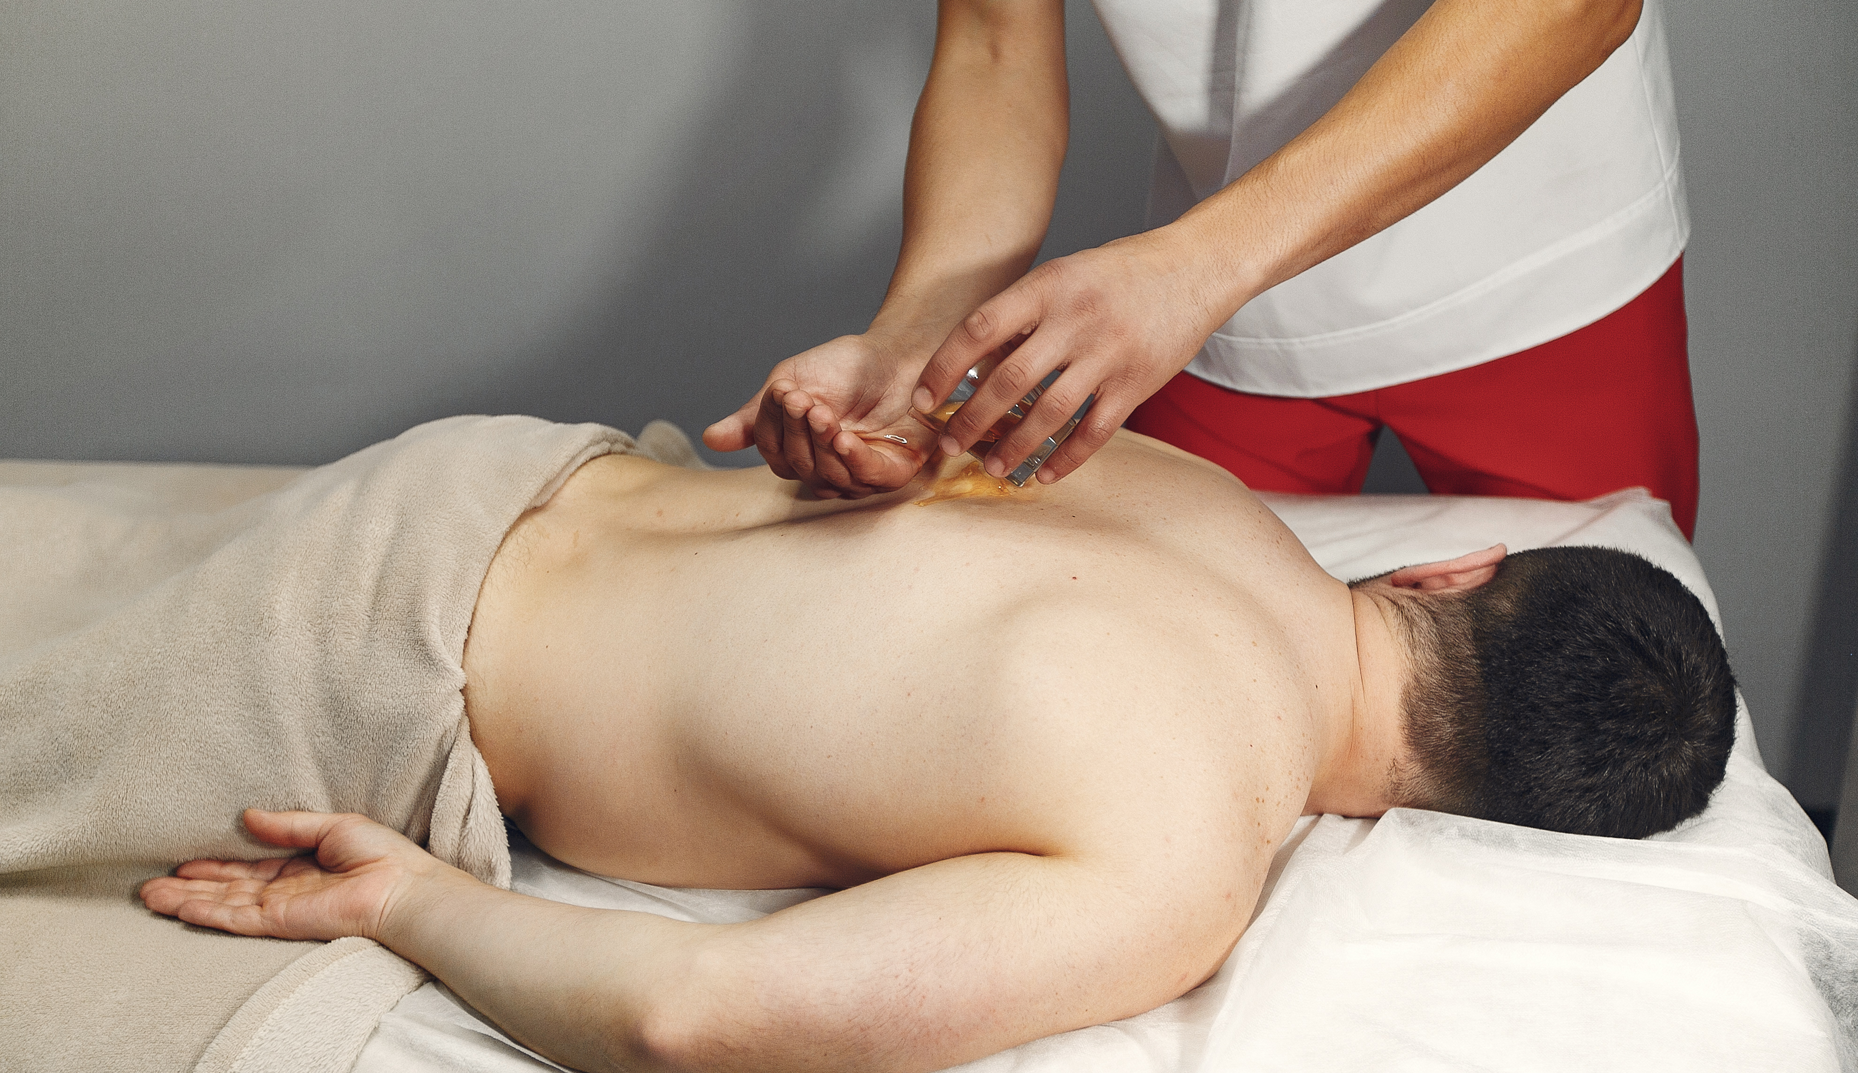
Sports Massage
Scientific research studies revealed manual massage not only improves performance directly but also delayed onset of muscle soreness.
At SIMC, our 2200 hrs qualified RMT thoroughly examine your nature of sport injury and apply cold / hot wraps and provide you appropriate treatment that helps you to overcome acute muscular injury and keep you fit for the next match.
Any pain during a physical activity should be addressed properly, otherwise it may lead to an increase risk of permanent deformity. Our well trained RMT will seek the expert advise from royal college of Physicians and surgeons (RCPS) to provide you appropriate treatment sessions and also update your family doctors about the treatment provided.
Massage Techniques
At SIMC we apply effective massage techniques by applying compression massage techniques performed by laying hands over a muscle area and pushing down on to the tissues. Hand are then lifted and moved to a different area and then repeated. The pressure compressions can range from light to very deep. After compressions other four strokes of Swedish massage (Effleurage, Petrissage, friction and tapotement will be followed.

Slide 4
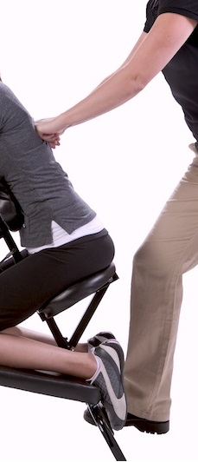
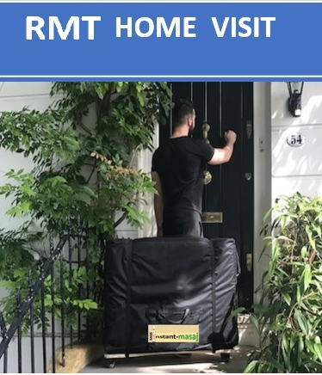
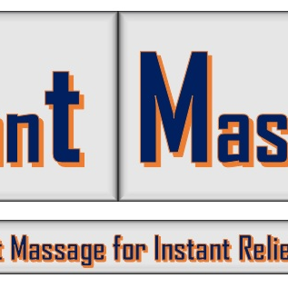
RMT at your door step
Are you tired of making appointment and long waiting for a massage?
We can help!
SIMC provide MT at Your Home.
Call now 1 (123)123 4567
Shoulder, neck stiffness and lower back pain often develops on prolong sitting during office hours. This can be treated with relaxation massage. Busy professionals may not get time for an appointment. No Worries We Cana Help!
At SIMC, a RMT is just one call away from your door step. RMT will carry a massage table / chair and all other massage consumables.
Contact
Abdul Samad (Massage Therapist)
2223 Victoria Ave E, Regina ​
Regina SK, S4N 6E4
Cell: 1 (306) -807 2012​
Instantmassgeinfo@gmail.com
https://saminstantmassaj.com/

Slide 5
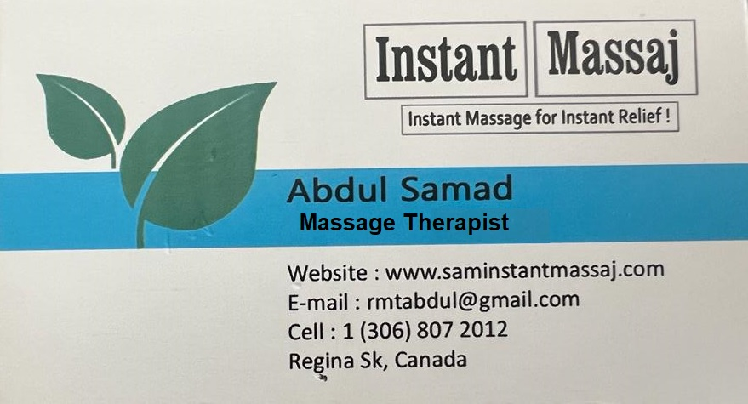
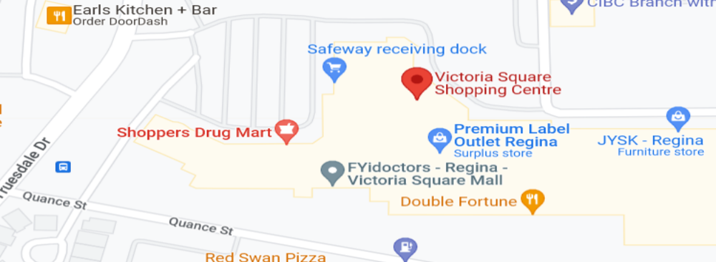
Business Card

Slide 6
Sources
Photos: https://www.freepik.com/ (free photos platform)
NSAID Articles:
https://www.researchgate.net/profile/Dora-Zelena/publication/221814774_The_healing_of_NSAID-induced_gastric_lesion_may_be_followed_by_small_intestinal_and_cardiovascular_side_effects/links/00b4952fb694b32c26000000/The-healing-of-NSAID-induced-gastric-lesion-may-be-followed-by-small-intestinal-and-cardiovascular-side-effects.pdf
https://www.tandfonline.com/doi/full/10.1080/00913847.2018.1553468?scroll=top&needAccess=true
Hot Stone Massage Benefits
https://apcz.umk.pl/JEHS/article/view/6322
Sports Massage
https://bmjopensem.bmj.com/content/bmjosem/6/1/e000614.full.pdf

